Slide 1
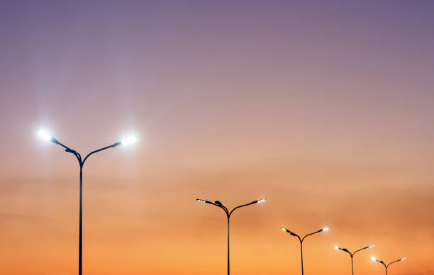
ES2103 - Ecology and Environment
Smart Street light system
Group 11

Slide 2
AIM:
This aims to contribute for “Sustainable cities and communities” by designing a fully automated street lighting system which aims to decrease in over usage of electricity and the CO2 emissions caused.
This also helps in minimizing the human interference in the operation.

Slide 3
Roles:
Sensors information, positioning and mathematical calculations need for physical model :
Meghana - ME20B023, Yaswanth- ME20B014
Circuit Designing :
Venkata Tarun- EE20B012, Sai Dattu -EE20B039, MP Varun Kumar - EE20B019
Arduino source code :
Sanjay -EE20B037, Dhanush -EE20B036
Hardware implementation and testing :
Kaushik - EE20B026, Jessica - ME20B022
Identifying the drawbacks and suggesting changes:
Jaswanth - EE20B034, Chaitanya- CH20B012

Slide 4
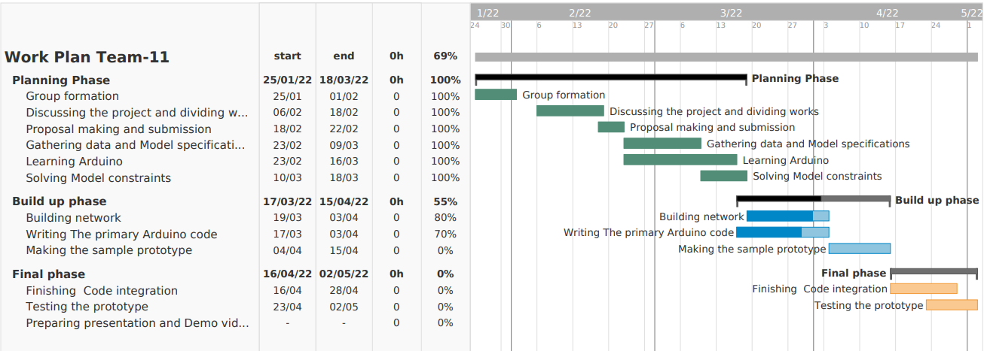
Work Plan:

Slide 5
Progress:
Basic Arduino modules needed for the final code covered
Circuit elements acquired :
Sensors :- Passive IR Sensor, Proximity sensor , LDR sensor, Arduino UNO
Identifying constraints:
Vehicle presence can’t be detected with a PIR sensor alone
Turning on individual street lights when object detected can be inconvenient for Vehicles
Lights need to be turned on manually at nights.

Slide 6
Progress:
Solutions obtained:
Infrared Proximity sensors to be used instead, which toggles the state of the light when motion is detected.
4 lights ahead of the vehicles get turned on when one sensor
senses it. Considering the distance between two lights is 20m.
and the lights dims only after 2 mins of inactivity
LDR sensors to be installed to turn on the lights only in the night.

Slide 7
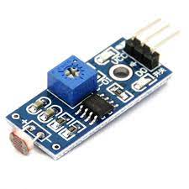
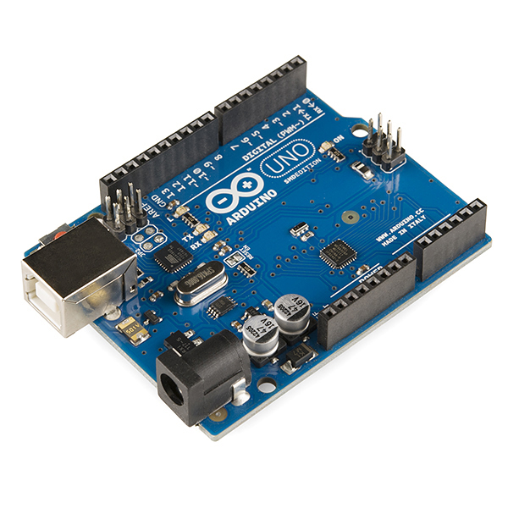
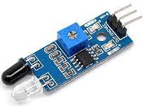
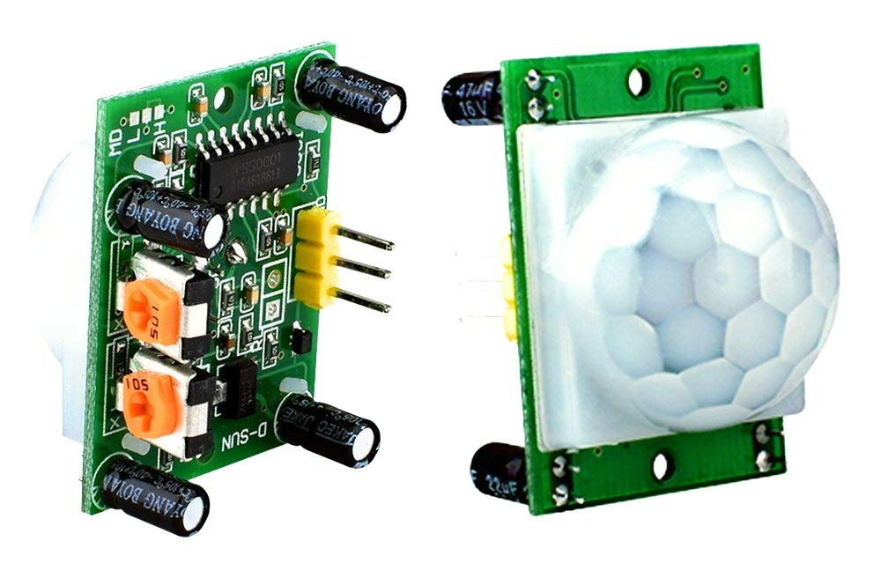
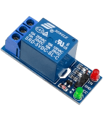
Sensors:
Arduino UNO
LDR sensor
Proximity sensor module
PIR sensor
Relay module

Slide 8
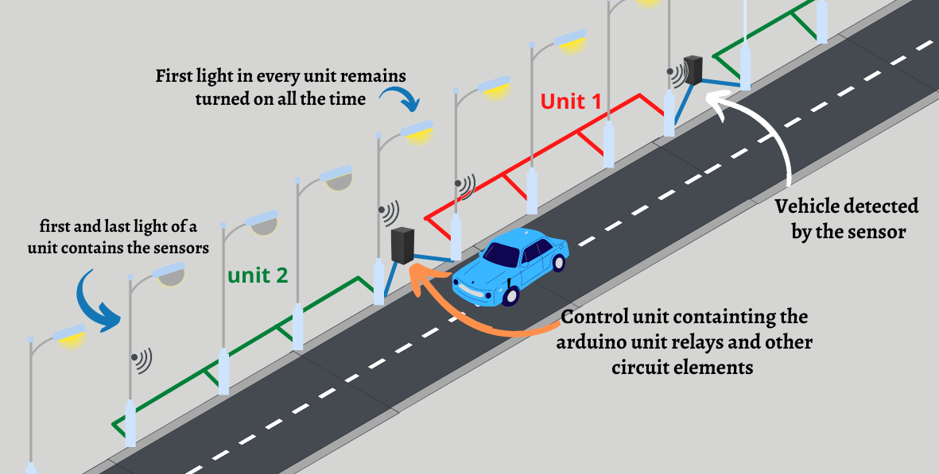
Model overview:
Each unit operates independently.
Control unit to manage all components
The first and last lights in each unit holds the sensors which conveys the information of the arrival of a vehicle to the processing unit which in turn turns on the rest of the lights in the unit.

Slide 9
Power consumption analysis:
Wattage of each light = 80-70W (x4)
Lighting Duration each day = 6pm - 6am = 12 hours
Net Electricity consumption= 3.84kWh
Taking the case that 3 of the lights are turned off when no traffic is detected
And considering
6pm to 10pm and 5am to 6am = traffic hours
7 out of the remaining 9 hours = zero traffic hours
Net electricity consumption ≈ 2kWh
Overall savings = 1.8kWh per a unit of 4 street lights each day

Slide 10
To Do:
Writing the arduino code to govern the system
Checking the suitability of the sensors and components
Testing the prototypes by subjecting to various cases

Slide 11
THANK YOU

